Slide 1
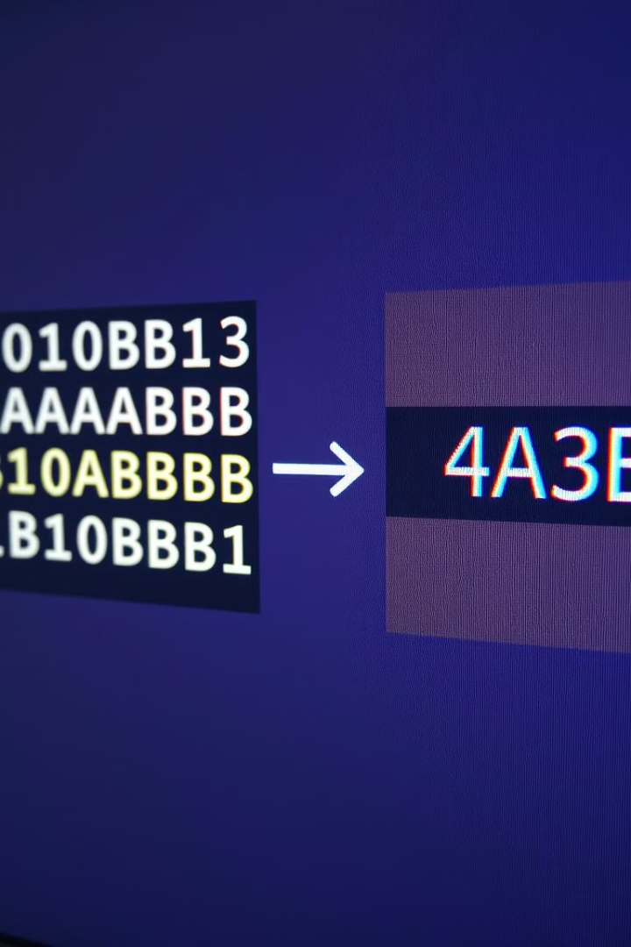

RLE: Smart Image Compression
Lossless, Fast, Everywhere
Hyder Presswala
Roll no. : 16010122151
Batch : A-4 COMPS TY
Subject : DSIP

Slide 2
📑 Table of Contents
What is Run-Length Encoding (RLE)?
How RLE Works !
Image Processing Pipeline
RLE: Strengths & Weaknesses
Common Uses of RLE
Why RLE Matters
Summary
Thank You

Slide 3
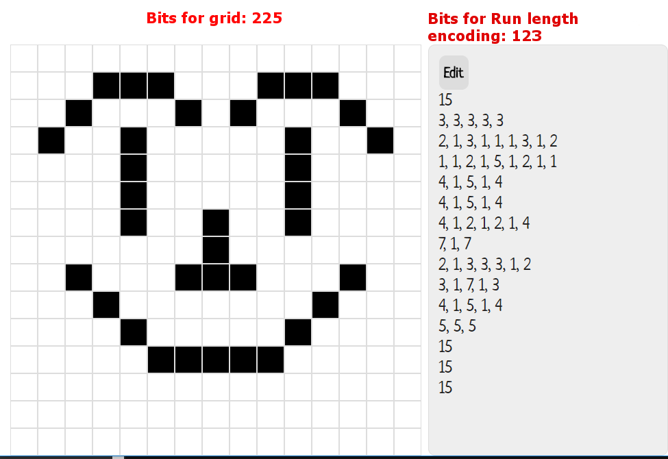
What is Run-Length Encoding (RLE)?
Run-Length Encoding (RLE) replaces consecutive repeats with (value, count) pairs. For example, `[0,0,255,255,255]` becomes `2x0, 3x255`. It is a lossless data compression algorithm.
Value
Count
Pixel value
Number of repeats
Lossless
No data lost

Slide 4




How RLE Works
RLE works in three steps: Scan the data, count consecutive identical values, and compress by storing (value, count).
Scan
Count
Compress

Slide 5
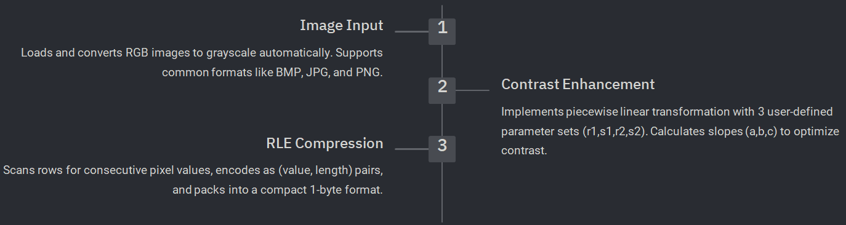
Image Processing Pipeline
This app provides a comprehensive image processing pipeline with the following capabilities:
Performance Metrics
Calculates compression ratio, redundancy, and validates decompressed image matches original dimensions.
Decompression & Visualization
Reconstructs image from binary data and displays comparison of original, processed, and compressed versions.

Slide 6
RLE: Strengths & Weaknesses
Strengths
Weaknesses
Simple implementation
Inefficient for noisy images
Fast compression/decompression
Poor compression ratio

Slide 7
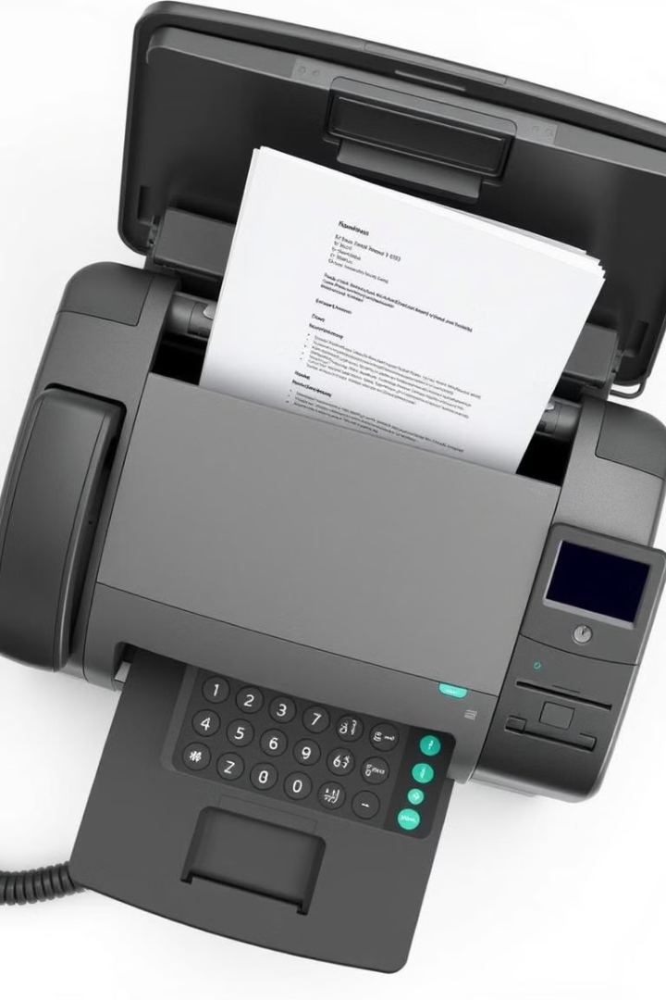



Common Uses of RLE
RLE is used in fax machines, QR codes, scanned documents, and simple image formats with large uniform regions.
Fax
QR Codes
Scanned Docs

Slide 8


Why RLE Matters
RLE is a foundation for advanced compression techniques. It's used with JPEG and MPEG codecs to compress repeating blocks in video.
1
Basic Tech
2
JPEG
3
MPEG

Slide 9

Summary
RLE = Repeat Counter: Simple but effective.
Simple and Effective
Fast
Foundational
Easy to understand and implement
Quick compression and decompression
Basis for modern codecs

Slide 10
THANK YOU!

